Slide 1
Twists and Turns: Paratubal Cysts & Bilateral Fallopian Tube Torsion in Adolescents
Martha A. Halford, MS¹; Ashley C. Dodd, MS²; Alexa Calfee, MD MPH³; Ramona Phinehas, MD⁴; Claudette Shephard, MD⁵
Author Affiliations :
¹⁻² College of Medicine
The University of Tennessee Health Science Center
Memphis, TN 38163
³⁻⁵ Department of Obstetrics and Gynecology
The University of Tennessee Health Science Center
Memphis, TN 38163
Presenting Author Contact:
M. Anna Halford, MS¹
mhalfor3@uthsc.edu

Slide 2
Introduction
Fallopian tube torsion (FTT) is isolated torsion of the fallopian unassociated with ovarian torsion, though ovarian pathology may be present.
In the pediatric population, although FTT is still rare, it is more common due to anatomical considerations. ^{1, 2}
The primary presenting symptom is abdominal pain, therefore may mimic other common pediatric pathologies such as appendicitis. ²
Imaging for FTT is nonspecific, although data suggests first modality performed should be ultrasound, followed by computerized tomography (CT). ³
Laparoscopy, often resulting in salpingectomy, remains the gold standard for definitive diagnosis, treatment of FTT, and preservation of fertility.

Slide 3
Case
HPI: 10 y.o. female presenting with intermittent, vague RLQ abdominal pain x1 day. Went to OSH the day prior and was found on US and CT to have two right sided ovarian cysts with normal blood flow seen to both ovaries. At presentation patient denied any other symptoms other than RLQ abdominal pain. Patient described pain as sharp and intermittent. LMP was 7 days prior. Patient is not currently sexually active. No active home medications.
PE: Afebrile and VSS, NAD. Physical exam only positive for mild tenderness to palpation in the RLQ of the abdomen with no distention, rebound, or guarding.
Lab: Patient’s hemoglobin was slightly low at 11.7 and her white blood cell (WBC) was 11.8. Urine microscopy from outside hospital was unremarkable. Gonorrhea and chlamydia PCR and cultures were negative.

Slide 4
Imaging
USG: OSH abdominal sonography revealed two large, right sided paraovarian cysts measuring 7.8 x 5.2 x 6.3 cm and 4.2 x 2..6 x 5 cm with normal vascular flow to both ovaries. Repeat abdominal sonography at pediatric hospital revealed prominent dilated tortuous tubular structures, most compatible with underlying hydrosalpinx, noncontiguous with both ovaries, and normal sonographic appearance of the uterus and bilateral ovaries with normal internal color Doppler flow (figure 1).
CT abdomen with contrast: OSH CT initially read as a 5 x 3.2 cm right ovarian cyst. Read over from pediatric radiologist suggested a right sided hydrosalpinx measuring 8.8 x7.9 x 6.1 cm (figure 2).

Slide 5
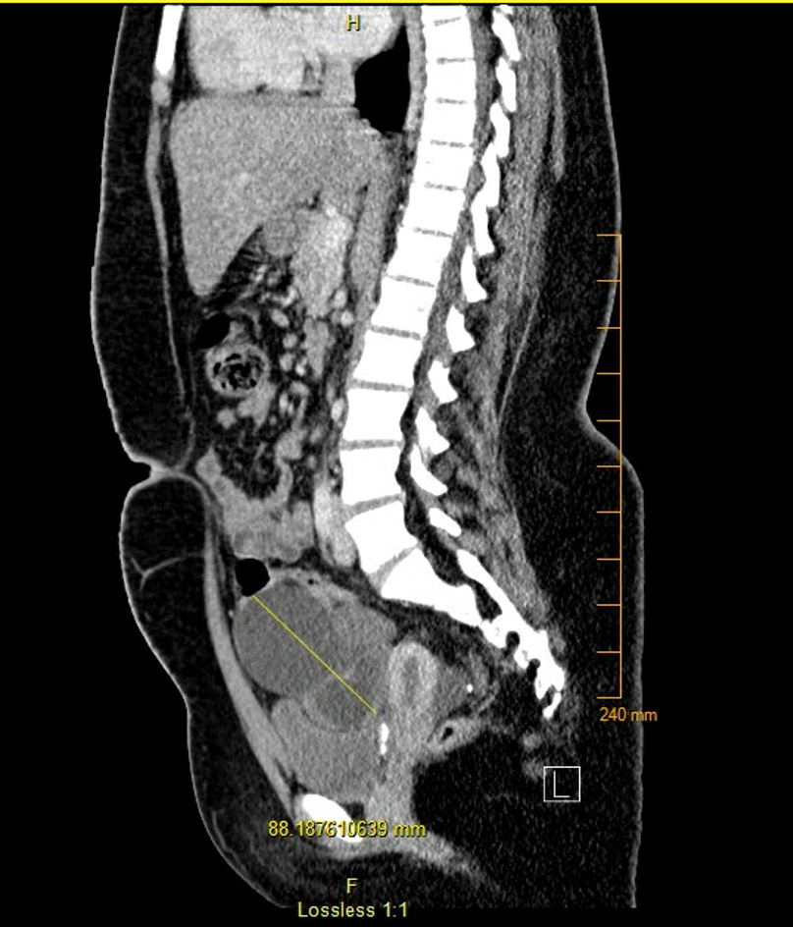
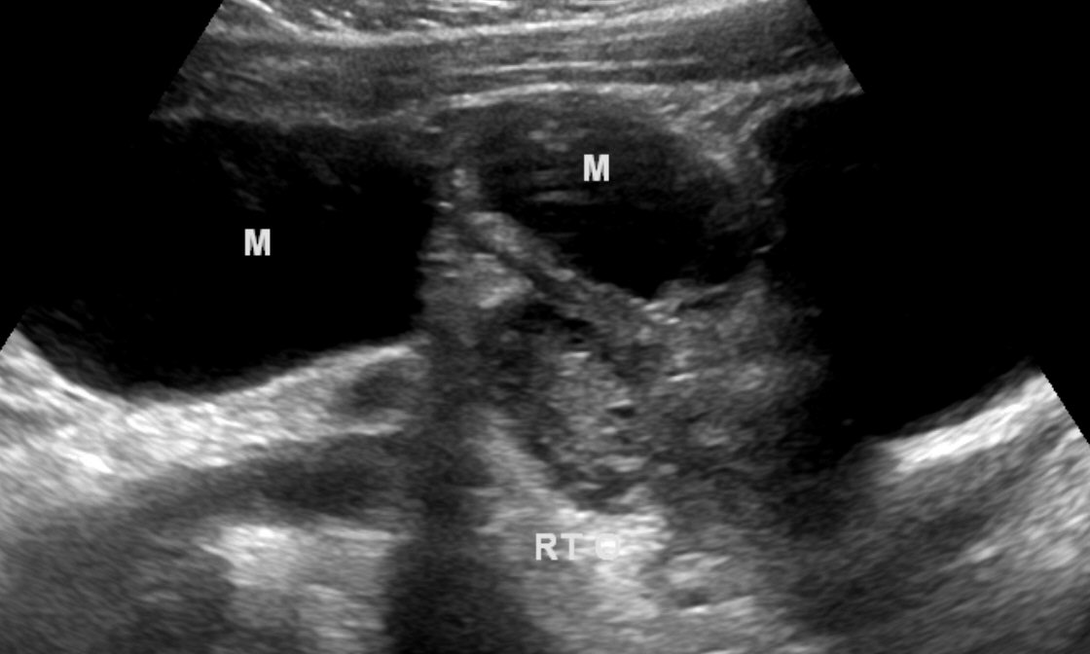
Imaging
Fig A
Figure (A) Sagittal CT image showing multiple dilated cystic structures (yellow line) adjacent to the uterus. Cystic images are consistent with R hydrosalpinx.
Figure (B) showing USG of normal R ovary (RO) with two cystic lesions (M)
Fig B
RO

Slide 6
Diagnosis & Management
A non-emergent diagnostic laparoscopy was performed the following day, and upon initial inspection, the left fallopian tube had undergone one complete rotation and contained a 5 x 5 cm paratubal cyst with 30 cc of clear aspirate. The right fallopian tube appeared to have undergone three complete rotations with a similarly sized paratubal cyst, which was removed.
Both the left and right fallopian tubes were detorsed. Following detorsion, the right fallopian tube appeared hemorrhagic and necrotic from the mid-portion of the tube through the fimbria, therefore a right salpingectomy was performed to removed the necrotic tissue. The left tube did not appear necrotic and following detorsion was able to be salvaged. This was attributed to only having undergone single torsion.
The uterus and ovaries were healthy appearing.
Pathology was significant for hemorrhage and necrosis without neoplastic contents.

Slide 7
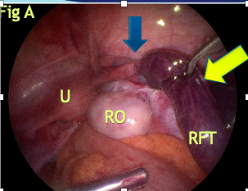
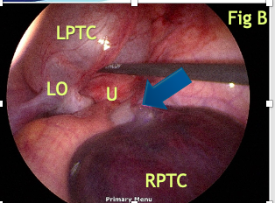
Surgery
Intra-operative image (A) shows twisting (blue arrow) of the mid right fallopian tube (RFT) and dilated, necrotic tube (yellow arrow)
Figure (B) shows a large paratubal cyst (LPTC) with twist (blue arrow)

Slide 8
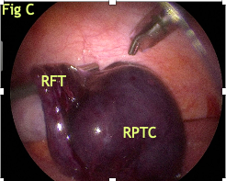
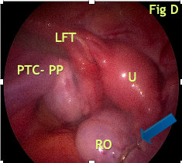
Surgery
Intra-op image (C) shows the necrotic right fallopian tube (RFT) and a large paratubal cyst (RPTC).
Figure (D) shows s/p puncture of the left paratubal cyst (PTC-PP) and detorsed LFT. Image also shows right ovary s/p R salpingectomy (blue arrow).

Slide 9
Discussion
Paratubal cysts are usually of paramesonephric origin, with the Hydatid cyst of Morgagni being the most common. ¹
The incidence of paratubal cysts is not clearly defined as many are asymptomatic. Muolokwu et al observed that of over fifteen hundred patients with a diagnosis of adnexal masses, the overall incidence of paratubal cysts was only 7%. ²
Paratubal cysts may cause symptoms and thus come to clinical attention because of enlargement, hemorrhage, or torsion. Several studies have shown a positive correlation with incidence of paratubal cysts and higher body mass index (BMI). ³

Slide 10
Discussion cont.
FTT is as rare as 1 in 1.5 million women.¹
In pediatric populations FTT is more common due to longer infundibulopelvic ligament, less restraint of the pelvic ligaments, and hypermobility of the fallopian tube at this age.²
In 2020, the rarity of FTT was demonstrated by a study reporting only 20 cases over 26 years at 5 different pediatric units, and none of these were bilateral FTT. ³
The first case report of bilateral FTT was published in 2018.

Slide 11
Discussion cont.
The major risk factor for FTT is an associated pathology. The pathologies observed were hydrosalpinx, paratubal cysts, and ovarian cysts. Although some observed cases were without identifiable pathology.
Also implicated, are sudden body changes and participation in sports. However, there are limitations in strongly associating FTT and sports due to very small sample sizes.

Slide 12
Discussion cont.
In all cases of FTT reviewed, the patient presented with acute abdominal pain. The majority of cases also reported nausea and vomiting and leukocytosis was observed in most cases.^{1, 2, 3}
A radiologic evaluation of 10 cases of surgically proven FTT reported that the first imaging that should be obtained is ultrasonography, and follow up imaging with CT if needed. However, in this study, only half of the patients had CT and only 3 of those should a dilated tubular structure. ⁴
In our case, as well as other studies, imaging modalities remains rather non-specific for fallopian tube torsion, therefore direct visualization with diagnostic laparoscopy remains the gold standard in treatment at this time.⁵

Slide 13
Discussion cont.
Management of FTT is controversial between salpingectomy vs a more conservative approach of detorsion. Salpingectomy is more common if there is concurrent ovarian pathology. In all reviewed cases, except one, FTT secondary to paratubal cysts was repaired with salpingectomy.
One study did maintain they would suggest salpingectomy if the level of damage resulted in significant scaring, which is in contrast to the current recommendation for ovarian torsion, when salvaging the ovary is of high importance due to known morbidities that are associated with loss of ovarian function at a young age.

Slide 14
Conclusion
It is paramount to highlight the importance of having a high clinical suspicion of FTT within pediatric and adolescent populations presenting with abdominal pain.
Visualization of dilated fallopian tube in the presence of normal sized ovaries with intact blood flow should be concerning for fallopian tube torsion.
Early diagnostic laparoscopy is key for both definitive diagnosis and treatment and to salvage fertility in the pediatric population.

